Slide 1
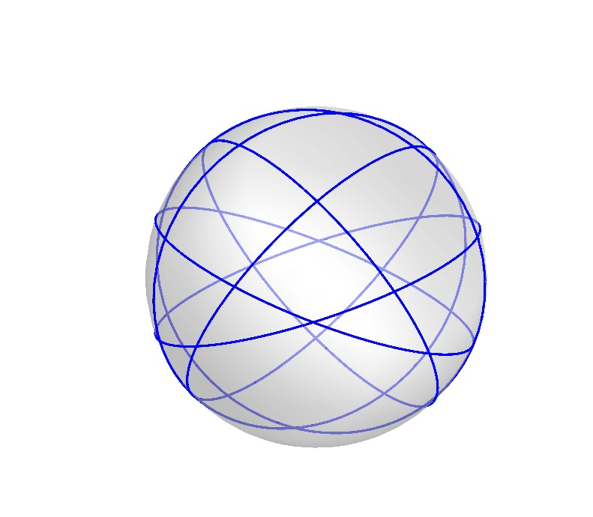
Great Circles Problem
Kha Man
1-15-2015

Slide 2

Outline
Problem restatement
2 example cases with 9 and 10 great circles
The big picture of the problem
The proof about 3 colourability for the problem ($χ\left(G\right)=3$ )

Slide 3
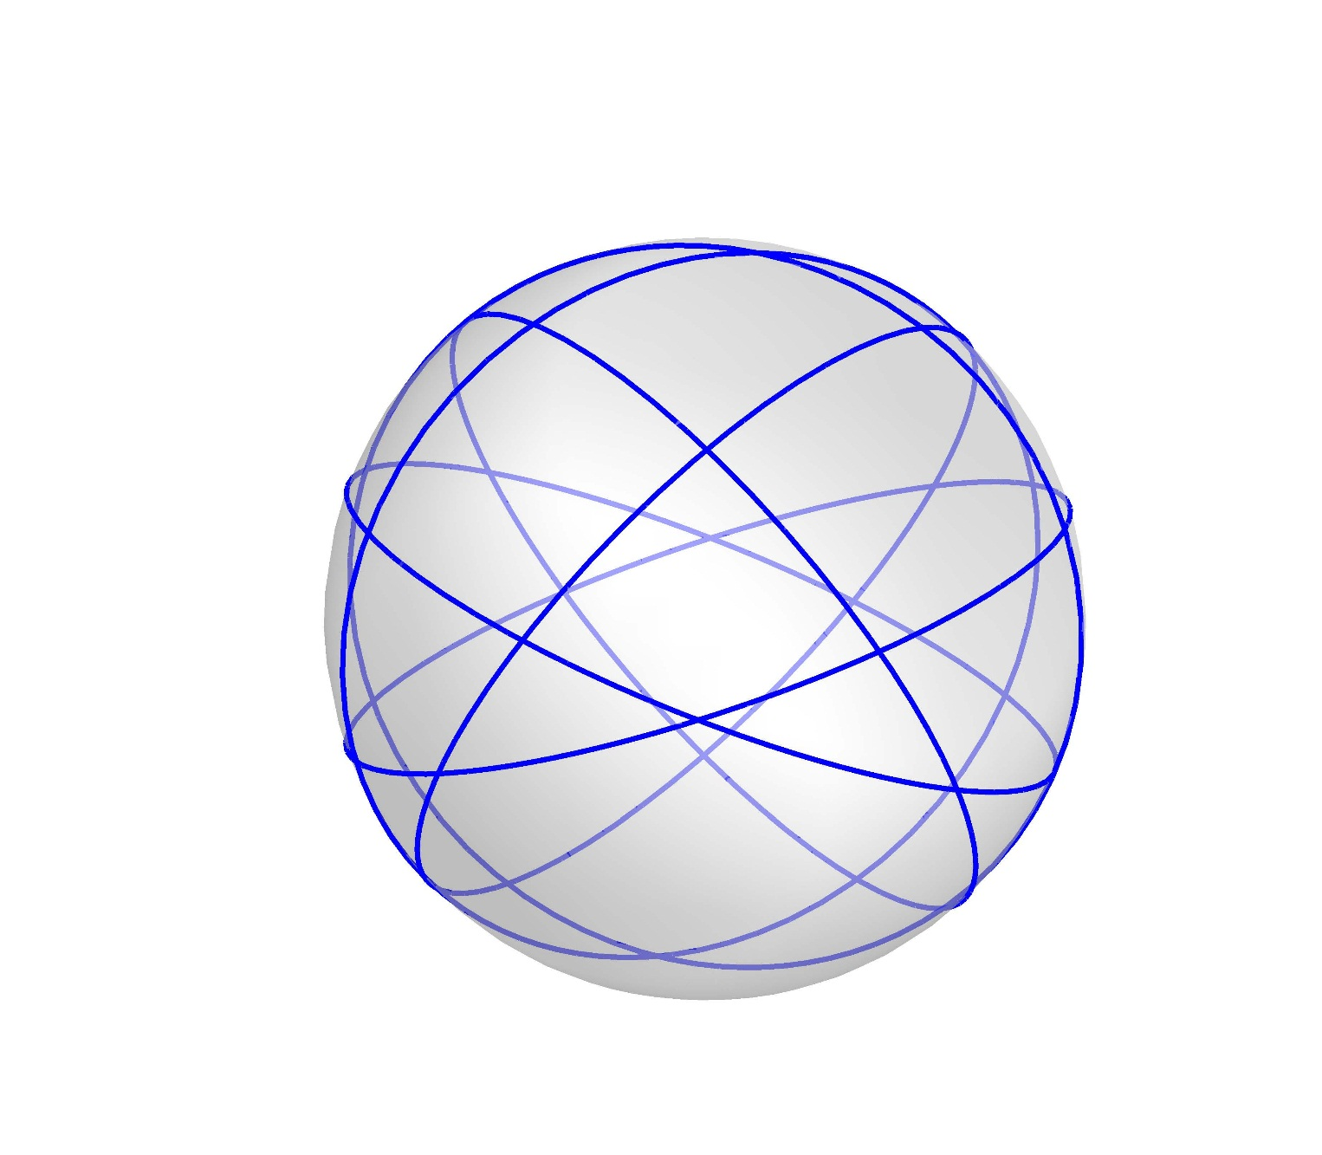
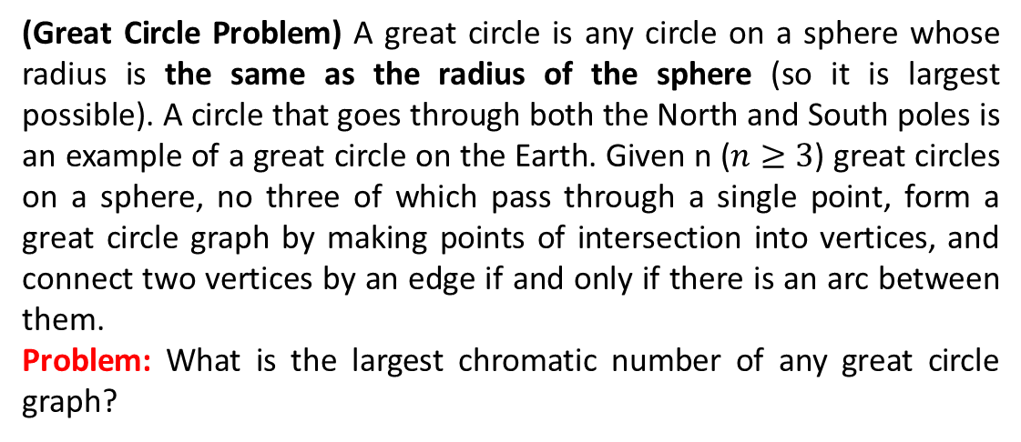
Problem Restatement
(Great Circle Problem) A great circle is any circle on a sphere whose radius is the same as the radius of the sphere (so it is largest possible). A circle that goes through both the North and South poles is an example of a great circle on the Earth. Given n ($n≥3$) great circles on a sphere, no three of which pass through a single point, form a great circle graph by making points of intersection into vertices, and connect two vertices by an edge if and only if there is an arc between them.
Problem: What is the largest chromatic number of any great circle graph?

Slide 5






Problem Restatement
Create ellipses with the inclination angle $τ$ [$\frac{−π}{2},\frac{π}{2})$ on the sphere
Why does this definition still keep the originality of the problem?
$$\frac{π}{4}$$
$$\frac{−π}{4}$$
$τ$= 0
$τ$= $\frac{π}{4}$
$τ$= $\frac{−π}{4}$

Slide 6
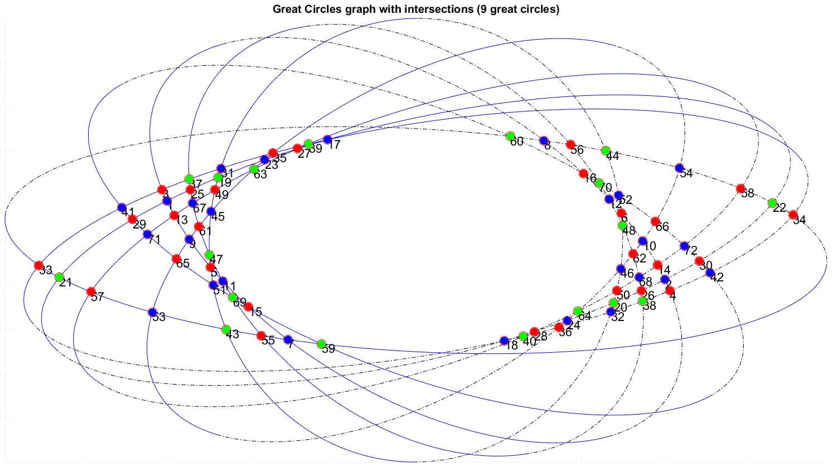
Problem Restatement

Slide 7
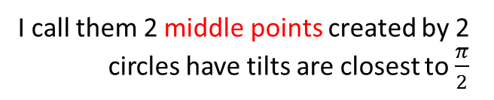
An example case (9 great circles)
I call them 2 middle points created by 2 circles have tilts are closest to $\frac{π}{2}$
. O
The middle line
: Top
----------- : Bot

Slide 8
A example case (9 great circles)
Observation:
The center of all circles O is the point symmetry of vertices on both sides of the line connected 2 middle points
Proof:
The cut of two ellipses is a line. Therefore, every couple of 2 ellipses will have 2 intersections and the center on the same line (Euclidean’s theorem) or O is the point symmetry of all intersections

Slide 9
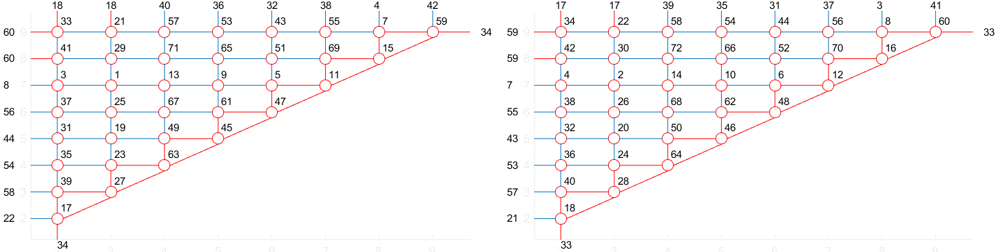
Redraw the graph (9 great circles)
Left side
Right side

Slide 10
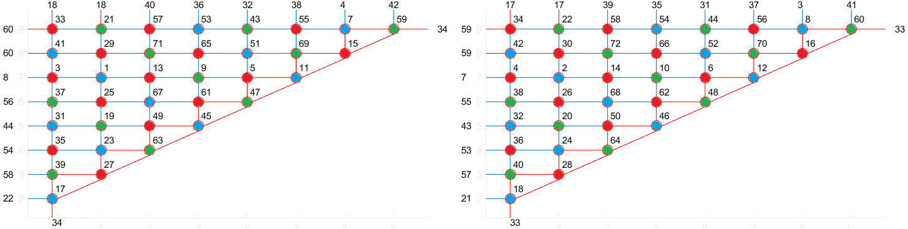
Color the graph
Left side
Right side
Observation: The vertices on the same diagonal usually have the same color

Slide 11
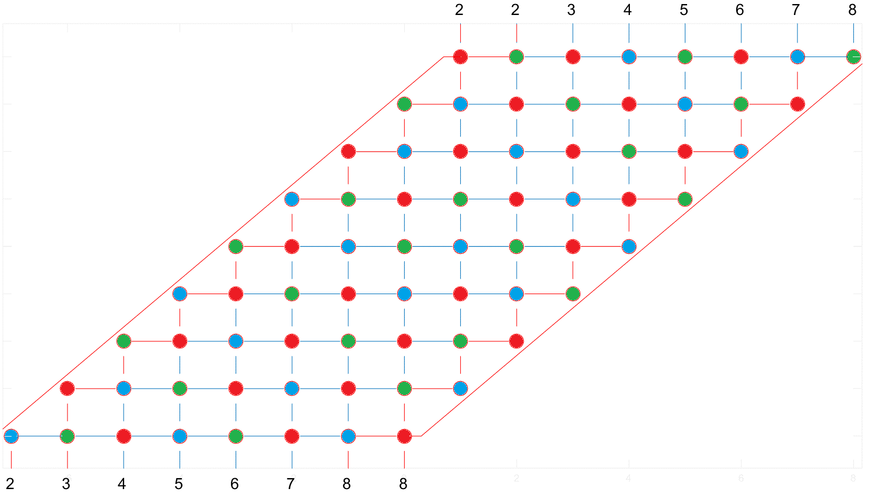
Color the graph
The numbers only show the connection in this graph only

Slide 12
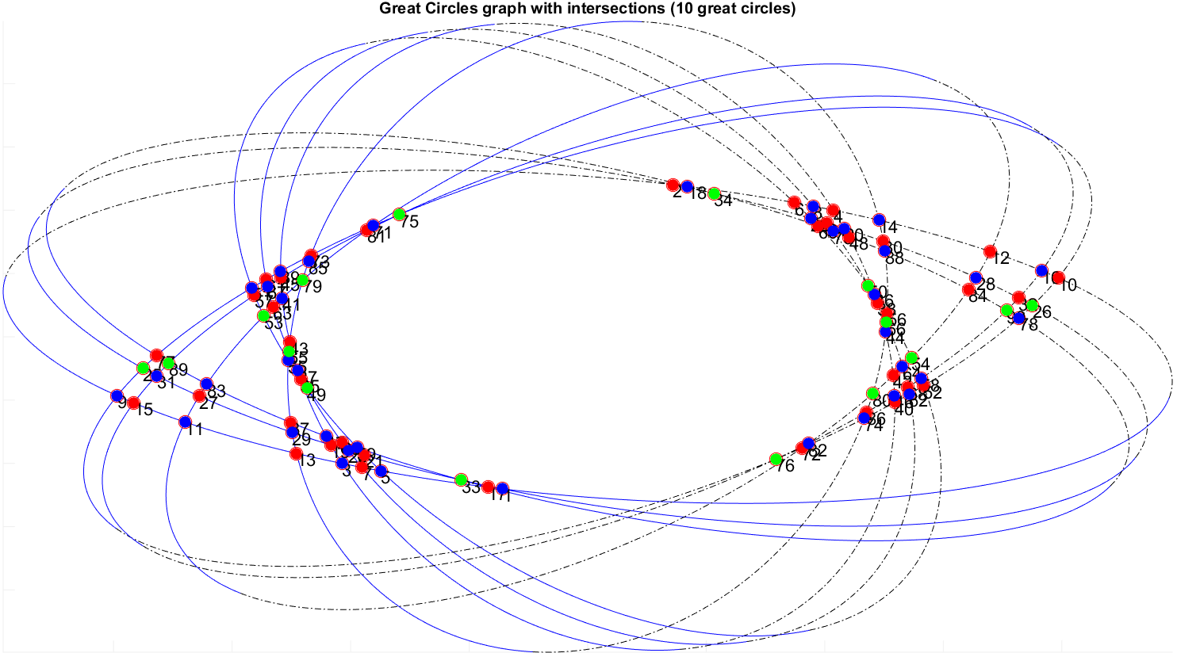
An another example (10 great circles)
. O

Slide 13
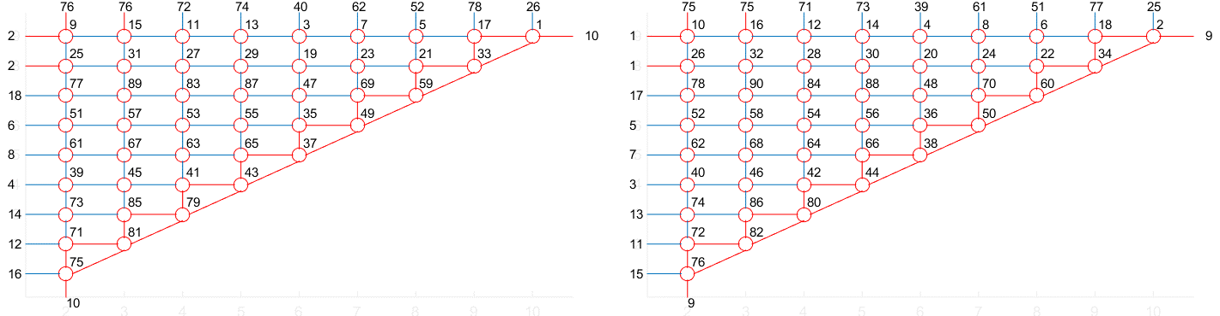
Redraw the graph (10 great circles)
Left side
Right side

Slide 14
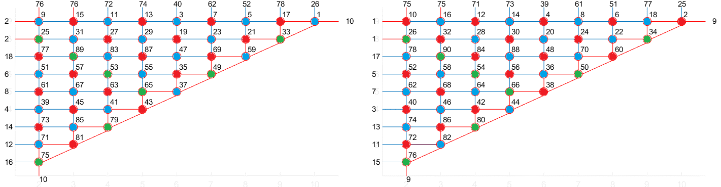
Color the graph (10 great circles)
Left side
Right side
Observation: The vertices on the same diagonal usually have the same color except ones on the hypotenuse

Slide 15

The big picture of the problem
Call E$τ_{i}$ is the ellipse has the inclination angle $τ_{i}$
and $τ_{1}<τ_{2}<…< τ_{n}$ $(τ_{i}∈[\frac{−π}{2},\frac{π}{2}))$

Slide 16










The big picture of the problem
E$τ_{4}$
E$τ_{3}$
E$τ_{5}$
E$τ_{2}$
E$τ_{6}$
E$τ_{1}$
E$τ_{7}$
E$τ_{8}$
. O
E$τ_{9}$
E$τ_{10}$

Slide 17
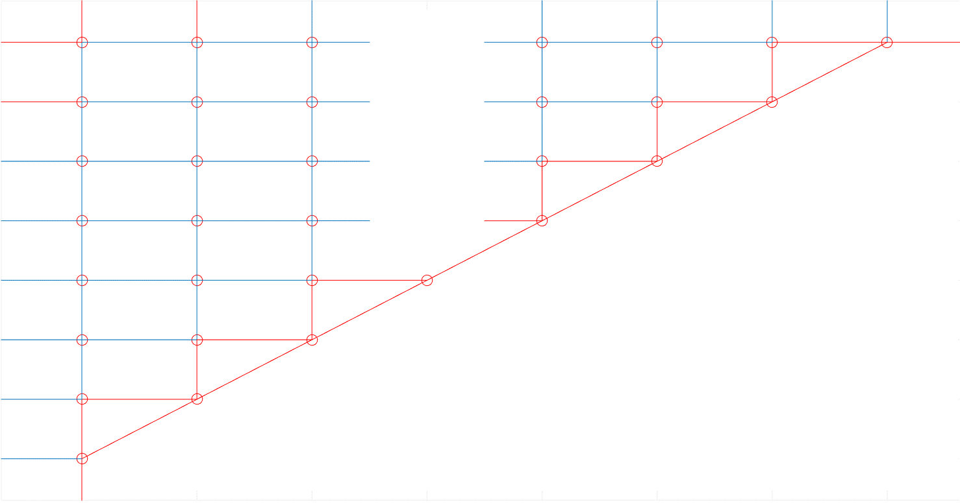




























The big picture of the problem
(n-1) vertices at the top
(n-1) vertices at the top
E$τ_{1}$
E$τ_{2}$
E$τ_{3}$
. . .
E$τ_{4}$
E$τ_{n−3}$
E$τ_{n−2}$
E$τ_{n−1}$
E$τ_{1}$
E$τ_{2}$
E$τ_{3}$
. . .
E$τ_{4}$
E$τ_{n−3}$
E$τ_{n−2}$
E$τ_{n−1}$
E$τ_{n}$
. . .
E$τ_{n}$
. . .
E$τ_{n−1}$
. . .
E$τ_{n−1}$
. . .
E$τ_{n−2}$
. . .
E$τ_{n−2}$
. . .
E$τ_{k}$
. . .
E$τ_{k}$
. . .
.
.
.
.
.
.
E$τ_{4}$
E$τ_{4}$
E$τ_{3}$
E$τ_{3}$
E$τ_{2}$
E$τ_{2}$
Left side
Right side

Slide 18
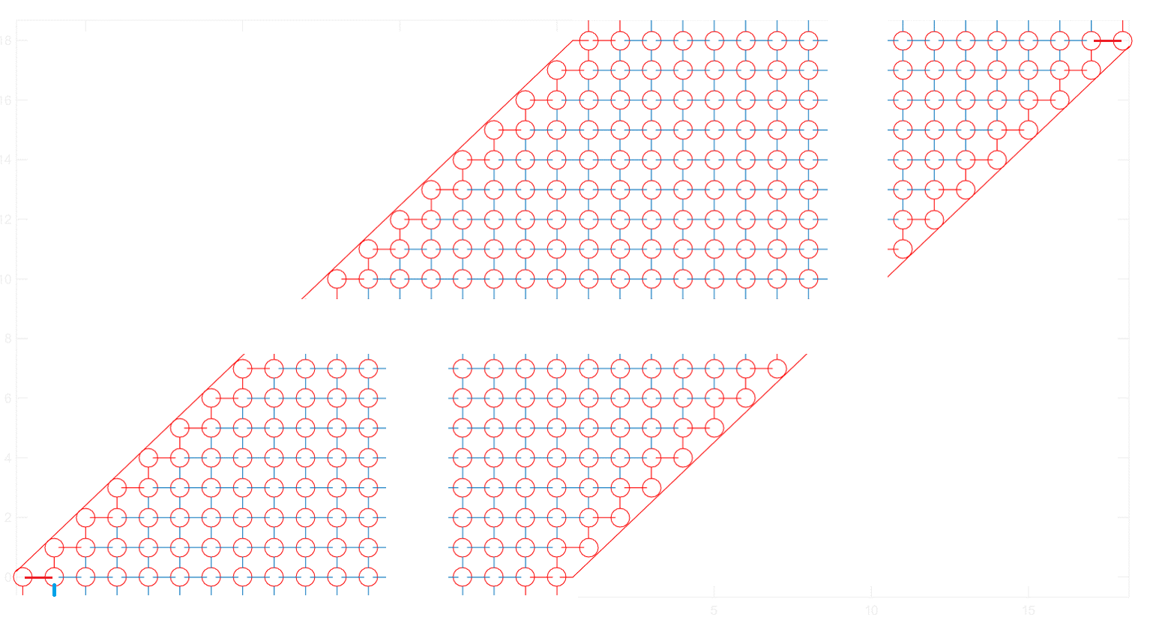
























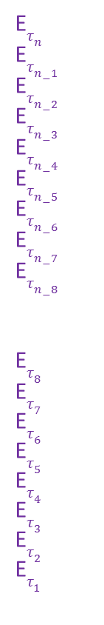








The big picture of the problem
E$τ_{2}$
E$τ_{3}$
E$τ_{4}$
E$τ_{7}$
E$τ_{n−6}$
E$τ_{n−5}$
E$τ_{n−5}$
E$τ_{n−4}$
E$τ_{n−2}$
E$τ_{1}$
E$τ_{5}$
E$τ_{6}$
E$τ_{8}$
. . .
E$τ_{n−4}$
E$τ_{n−3}$
E$τ_{n−1}$
Another equivalent graph with merged left and right sides
E$τ_{n}$
E$τ_{n−1}$
E$τ_{n−2}$
E$τ_{n−3}$
E$τ_{n−4}$
E$τ_{n−5}$
E$τ_{n−6}$
E$τ_{n−7}$
E$τ_{n−8}$
E$τ_{8}$
E$τ_{7}$
E$τ_{6}$
E$τ_{5}$
E$τ_{4}$
E$τ_{3}$
E$τ_{2}$
E$τ_{1}$
. . .
. . .
. . .
E$τ_{3}$
E$τ_{4}$
E$τ_{5}$
E$τ_{8}$
E$τ_{10}$
E$τ_{n−1}$
E$τ_{2}$
E$τ_{6}$
E$τ_{7}$
E$τ_{9}$
E$τ_{11}$
E$τ_{12}$
E$τ_{13}$
. . .
E$τ_{n−3}$
E$τ_{n−2}$
E$τ_{n}$
. . .

Slide 19
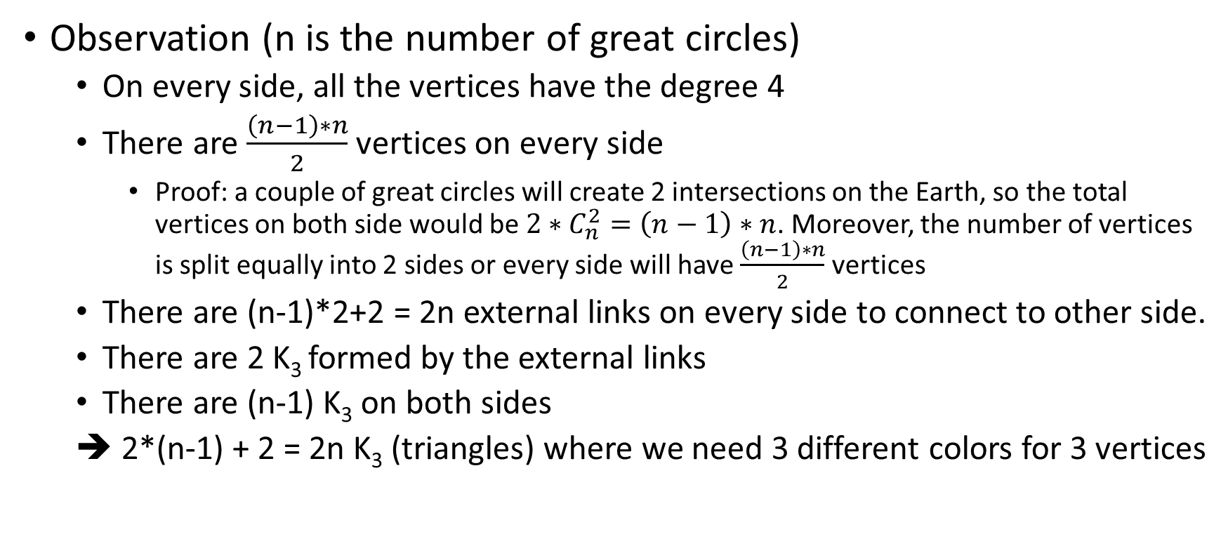
The big picture of the problem
Observation (n is the number of great circles)
On every side, all the vertices have the degree 4
There are $\frac{\left(n−1\right)∗n}{2}$ vertices on every side
Proof: a couple of great circles will create 2 intersections on the Earth, so the total vertices on both side would be $2∗C_{n}^{2}=\left(n−1\right)∗n$. Moreover, the number of vertices is split equally into 2 sides or every side will have $\frac{\left(n−1\right)∗n}{2}$ vertices
There are (n-1)*2+2 = 2n external links on every side to connect to other side.
There are 2 K₃ formed by the external links
There are (n-1) K₃ on both sides
➔ 2*(n-1) + 2 = 2n K₃ (triangles) where we need 3 different colors for 3 vertices

Slide 20
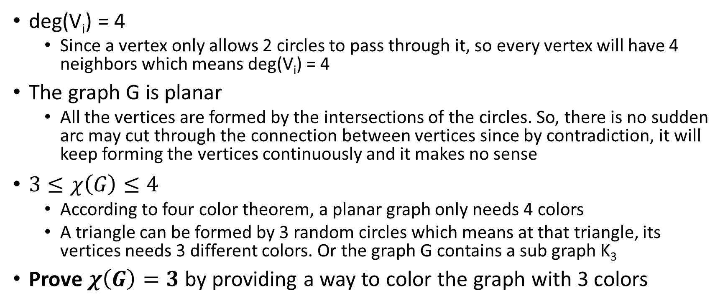
Chromatic number
deg(V_{i}) = 4
Since a vertex only allows 2 circles to pass through it, so every vertex will have 4 neighbors which means deg(V_{i}) = 4
The graph G is planar
All the vertices are formed by the intersections of the circles. So, there is no sudden arc may cut through the connection between vertices since by contradiction, it will keep forming the vertices continuously and it makes no sense
$3≤χ\left(G\right)≤4$
According to four color theorem, a planar graph only needs 4 colors
A triangle can be formed by 3 random circles which means at that triangle, its vertices needs 3 different colors. Or the graph G contains a sub graph K₃
Prove $χ\left(G\right)=3$ by providing a way to color the graph with 3 colors

Slide 21
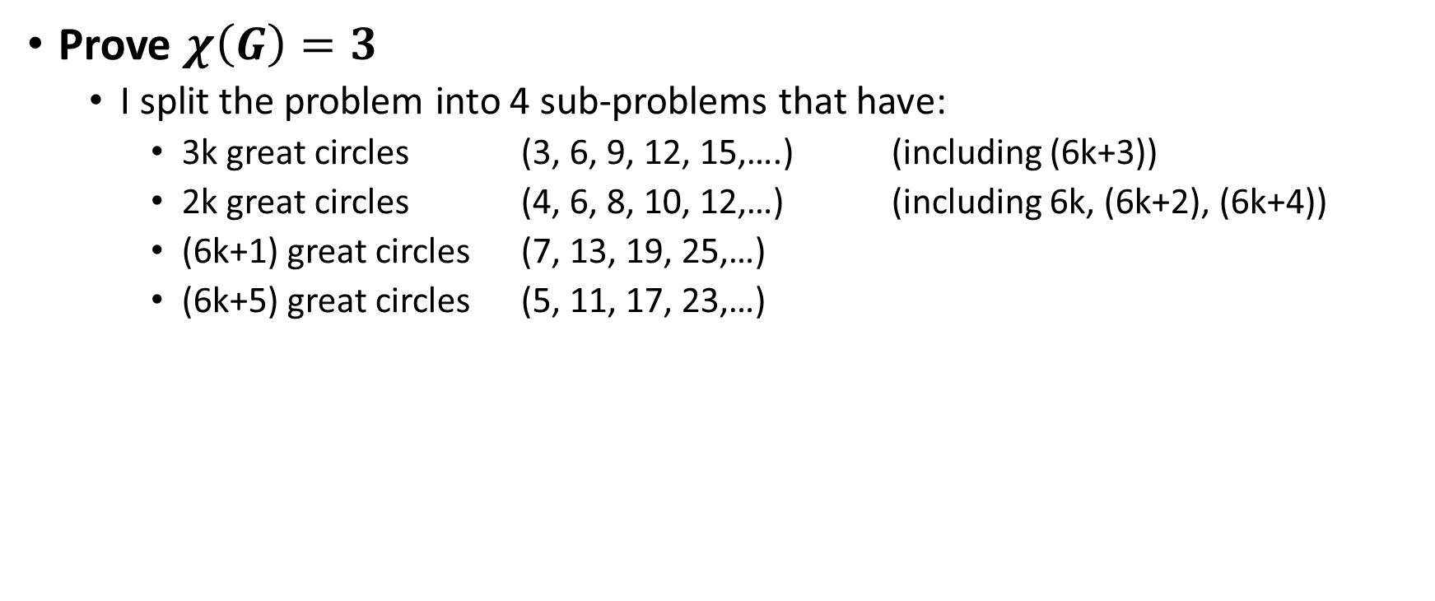
Chromatic number
Prove $χ\left(G\right)=3$
I split the problem into 4 sub-problems that have:
3k great circles (3, 6, 9, 12, 15,….) (including (6k+3))
2k great circles (4, 6, 8, 10, 12,…) (including 6k, (6k+2), (6k+4))
(6k+1) great circles (7, 13, 19, 25,…)
(6k+5) great circles (5, 11, 17, 23,…)

Slide 22
Chromatic number
Some rules before coloring
Diagonal rule: The vertices on the same diagonal should have the same color (not a must because there are some places might have K₃ rule)
Proof: The vertices on the same diagonal are not connected together.
K₃ rule: 3 vertices that form a triangle must have 3 different colors

Slide 23
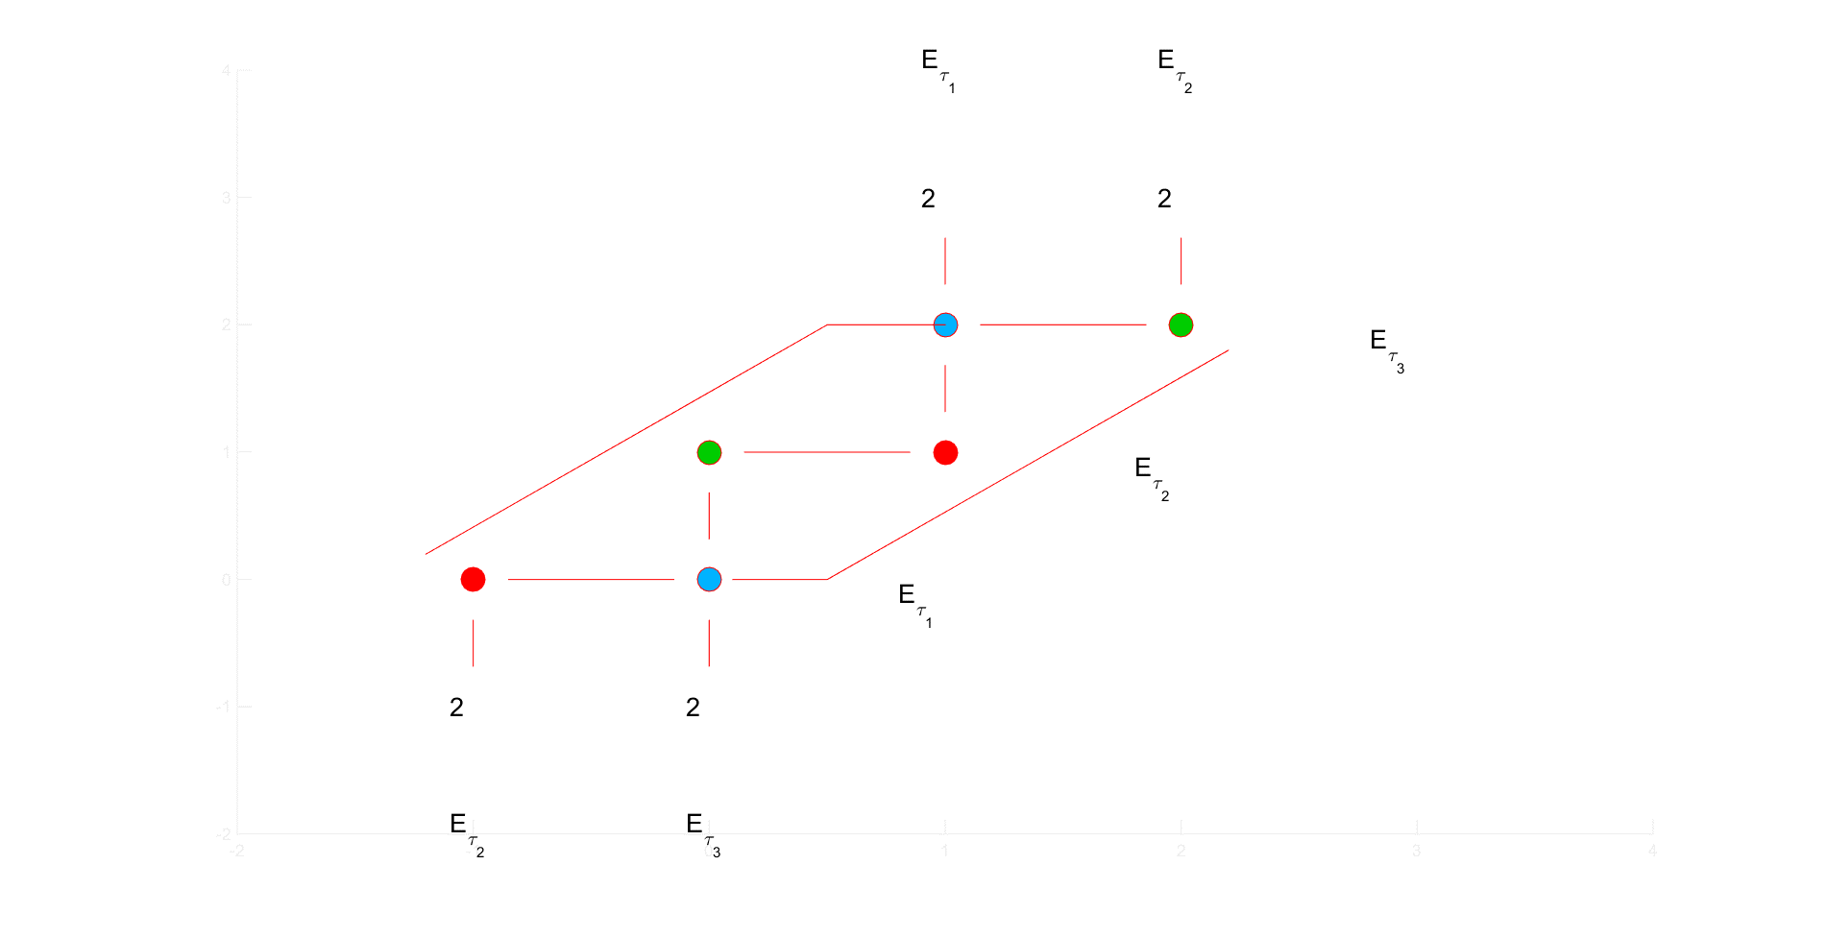
Chromatic number (with 3k circles)
Base cases: 3 great circles

Slide 24
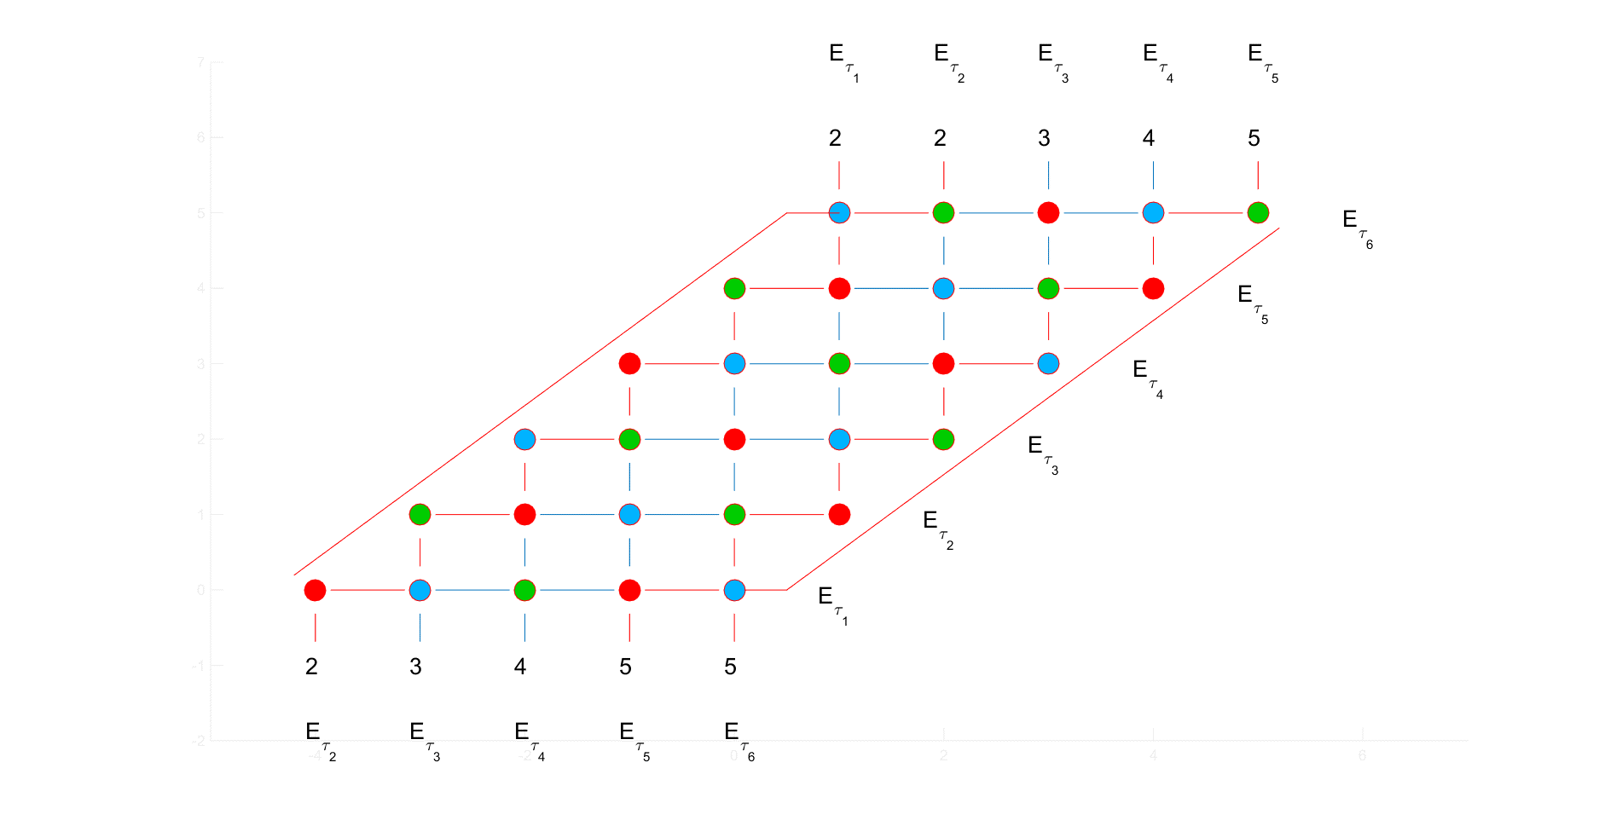
Chromatic number (with 3k circles)
Base cases: 6 great circles

Slide 25
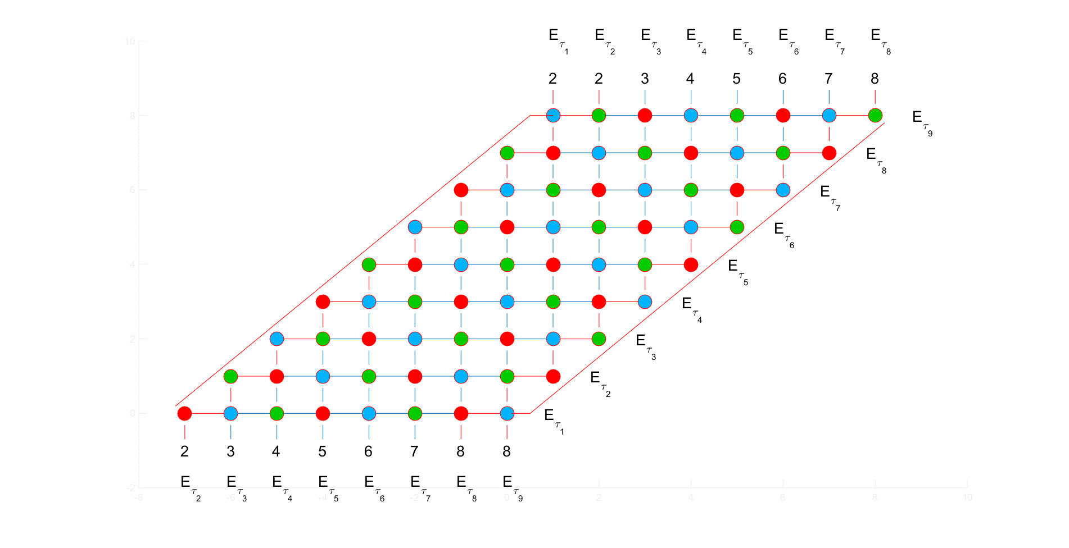
Chromatic number (with 3k circles)
Base cases: 9 great circles

Slide 26
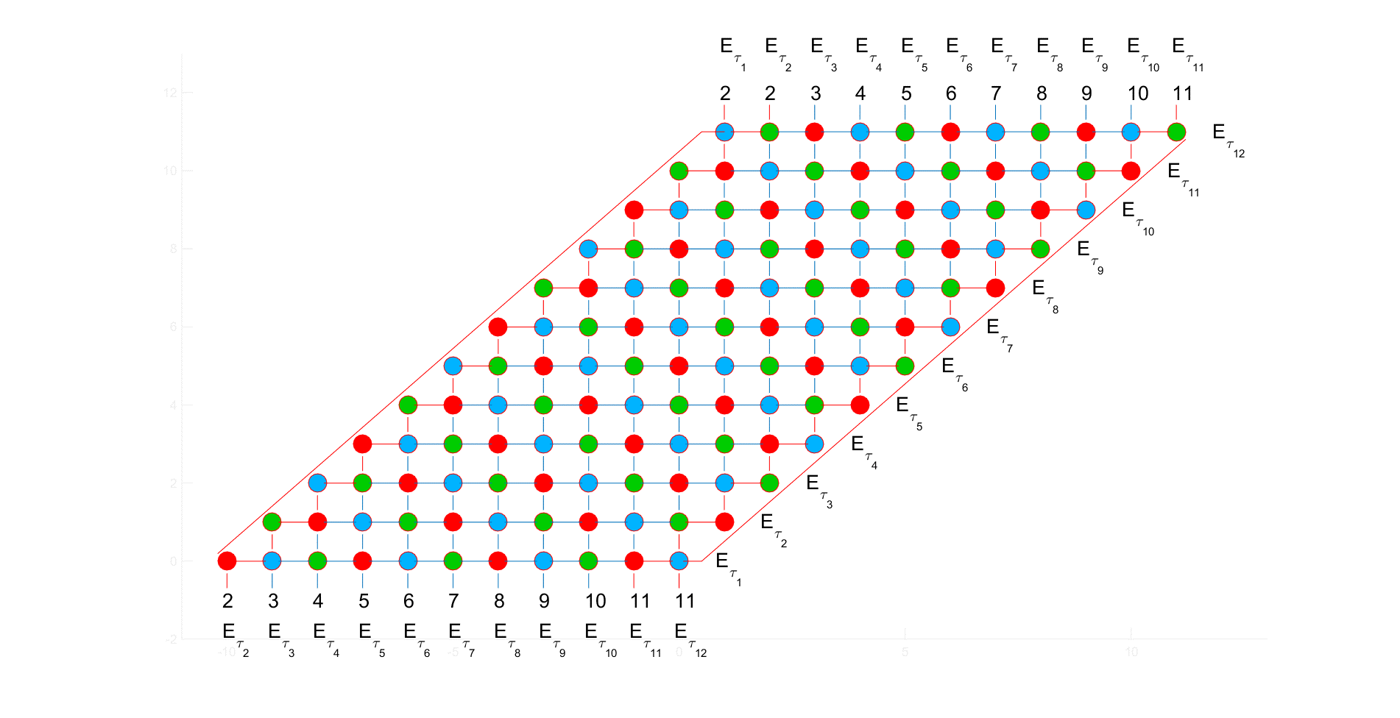
Chromatic number (with 3k circles)
Base cases: 12 great circles

Slide 27
Chromatic number (with 3k circles)
I can color a 3k circles graph with 3 colors by repeatedly spreading RED-BLUE-GREEN respectively on the diagonals
I can prove it by induction hypothesis
Proof:
Assume I can use this technique to color a 3k circles graph, so in 3(k+1) graph, the edges on the equivalent parallelogram are extended 3 more vertices on the top right and the bottom left. Then I can use RED-BLUE-GREEN to color the vertices with diagonal rule
This technique also satisfies K₃ rule

Slide 28
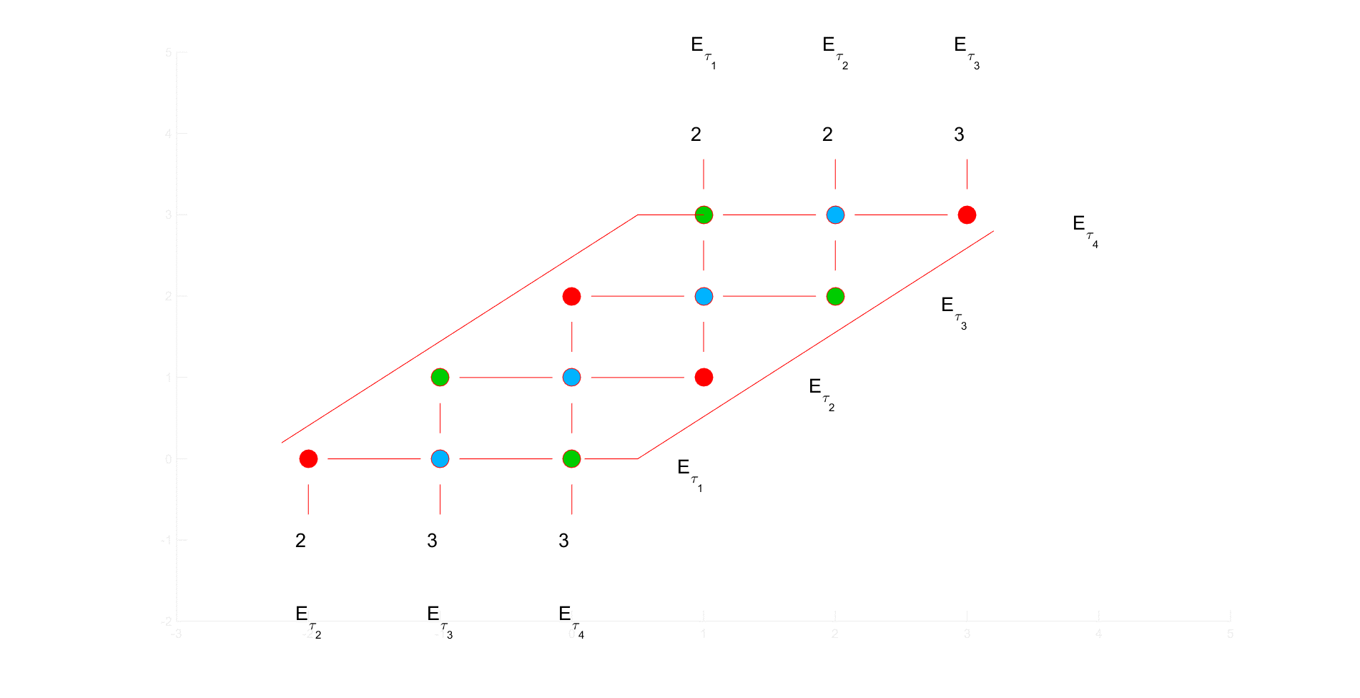
Chromatic number (with 2k circles)
Base cases: 4 great circles

Slide 29
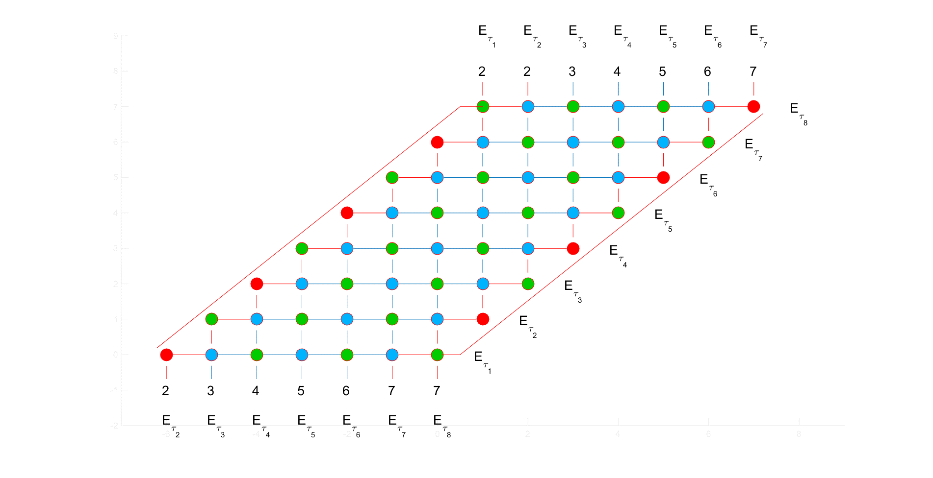
Chromatic number (with 2k circles)
Base cases: 8 great circles

Slide 30
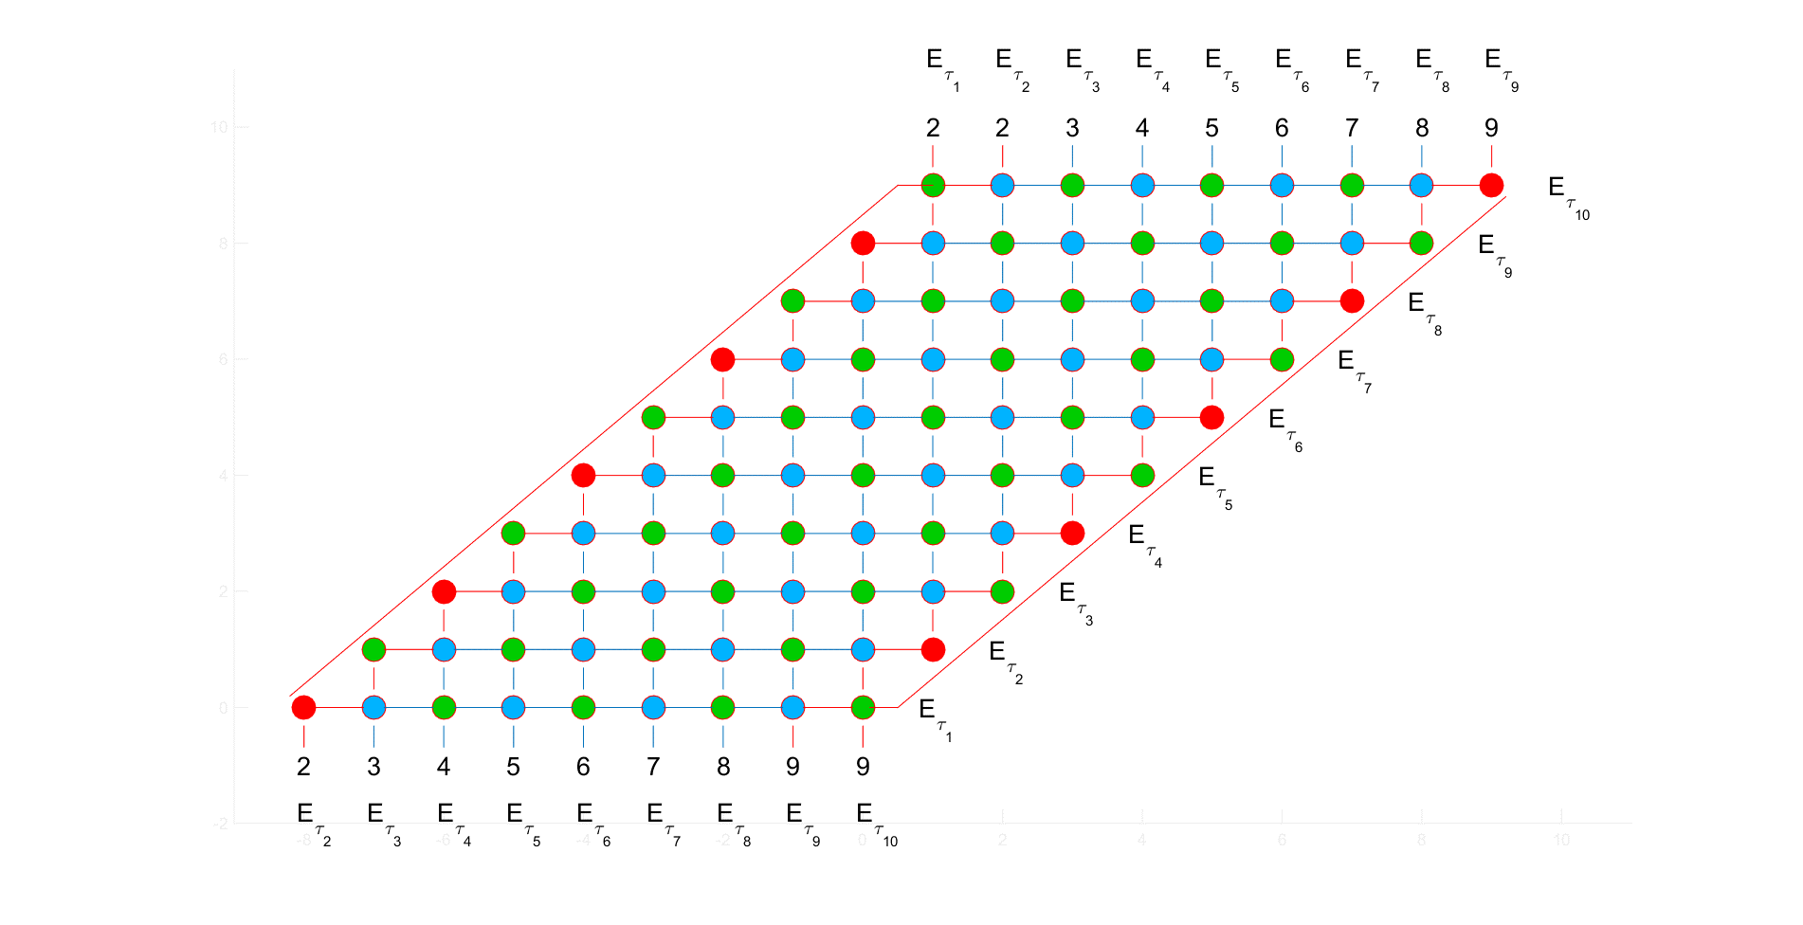
Chromatic number (with 2k circles)
Base cases: 10 great circles

Slide 31
Chromatic number (with 2k circles)
I can color a 2k circles graph with 3 colors:
Repeatedly spreading BLUE-GREEN respectively on the diagonals
Replace the red dots to the vertices on the left and right edges
Start with the first one at bottom left
Color R-G-R-G-R-G-…..-G
Start with the first one at bottom right
Color G-R-G-R-G-R-…..-R
Why can this technique be possibly done?
Easily find out that at the external links, there is no problem there since if by induction hypothesis, with 2(k+1) graph, I will keep spreading BLUE-GREEN
Adding red dots doesn’t matter the current graph with 2 colors. Moreover, it helps to satisfy 2 K₃ on the external links and other (2(k+1)-2) K₃ on the parallelogram edges

Slide 32
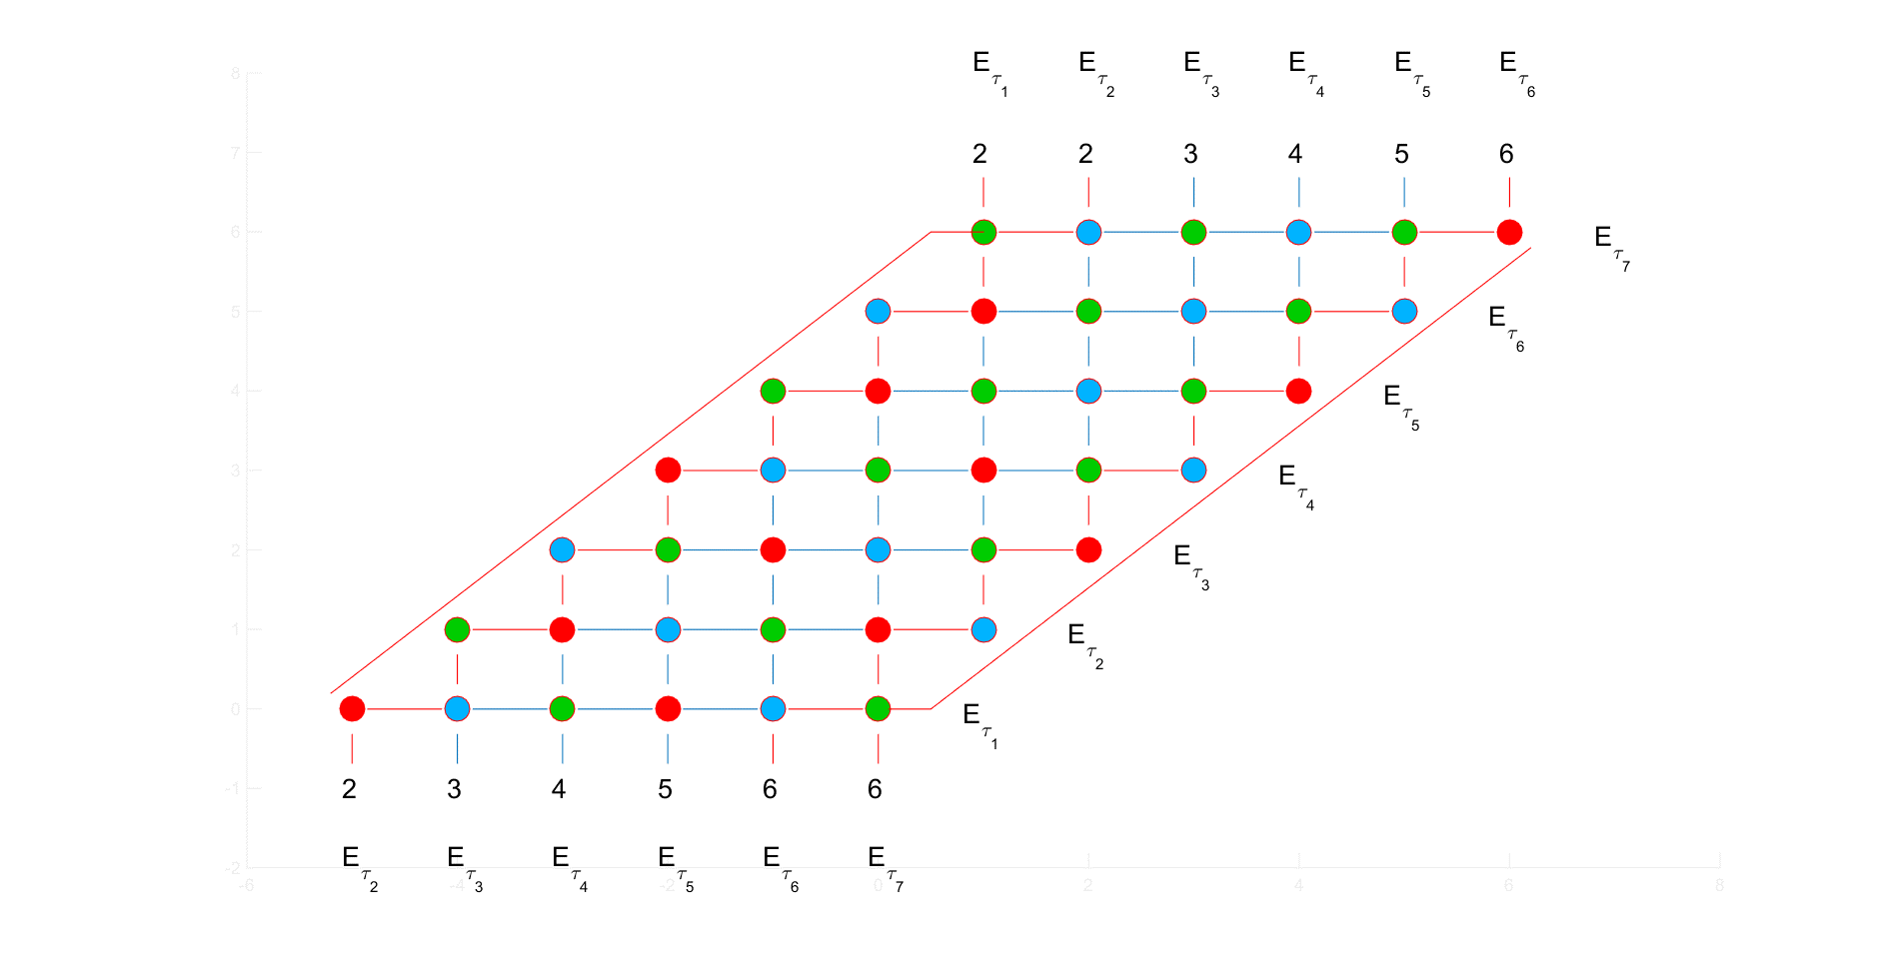
Chromatic number (with (6k+1) circles)
Base cases: 7 great circles

Slide 33
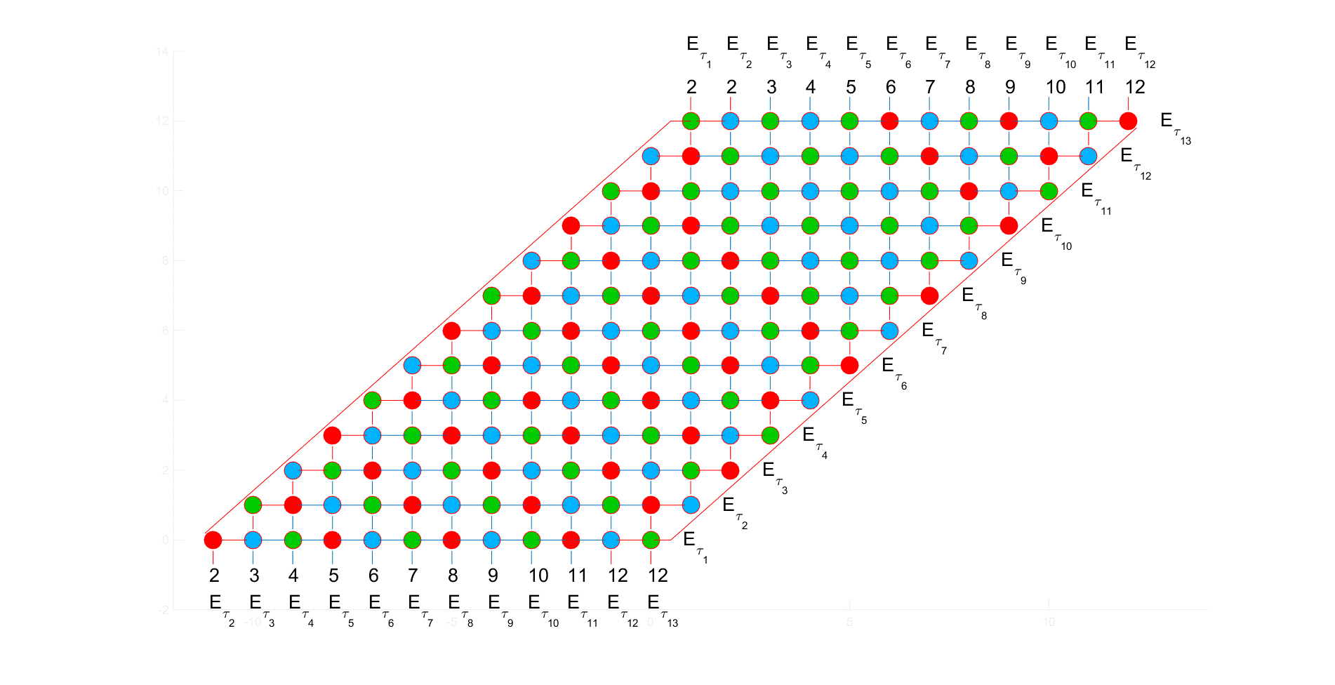
Chromatic number (with (6k+1) circles)
Base cases: 13 great circles

Slide 34
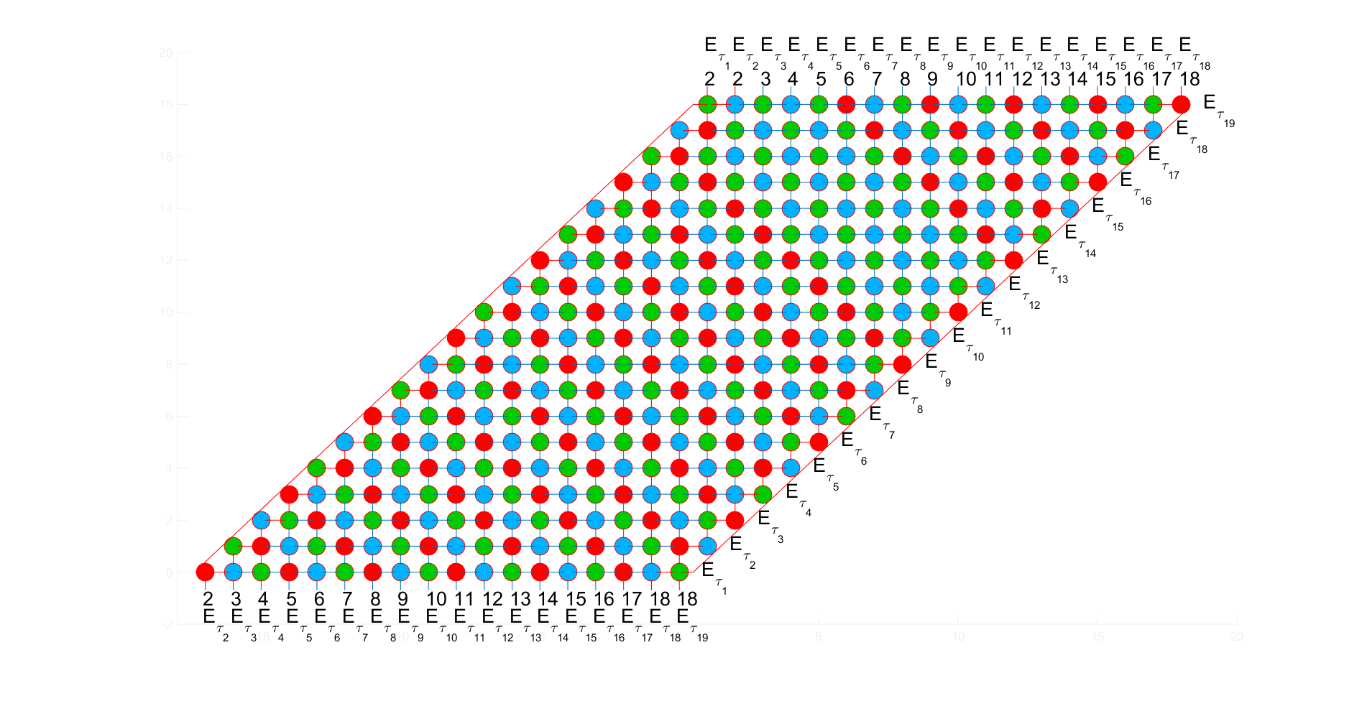
Chromatic number (with (6k+1) circles)
Base cases: 19 great circles

Slide 35
Chromatic number (with (6k+1) circles)
With k>2, by spreading RED-BLUE-GREEN respectively on the additional diagonals, I can color all this type of graph based on the case k=2

Slide 36
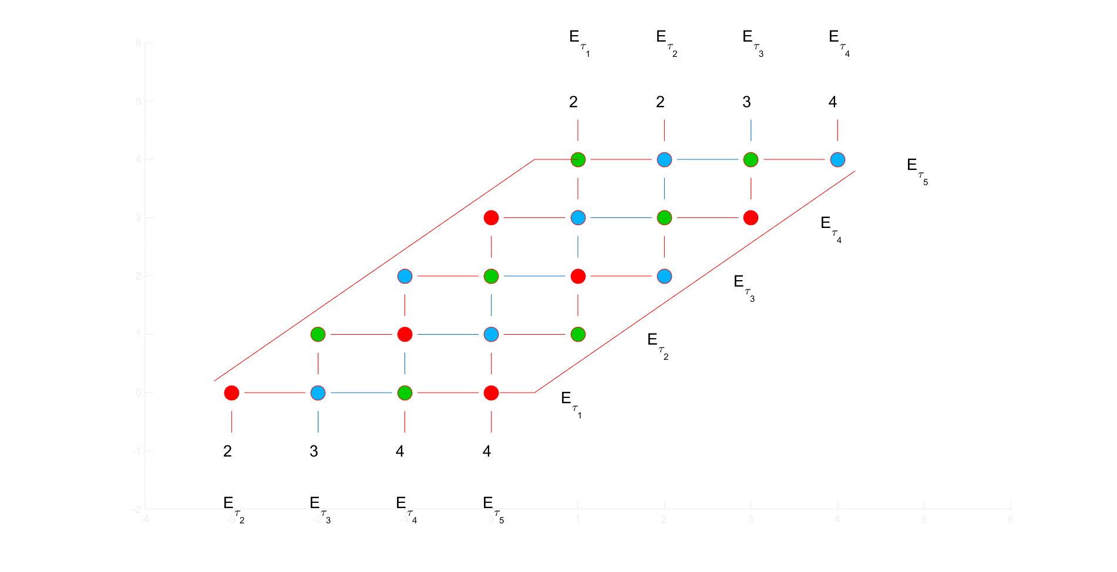
Chromatic number (with (6k+5) circles)
Base cases: 5 great circles

Slide 37
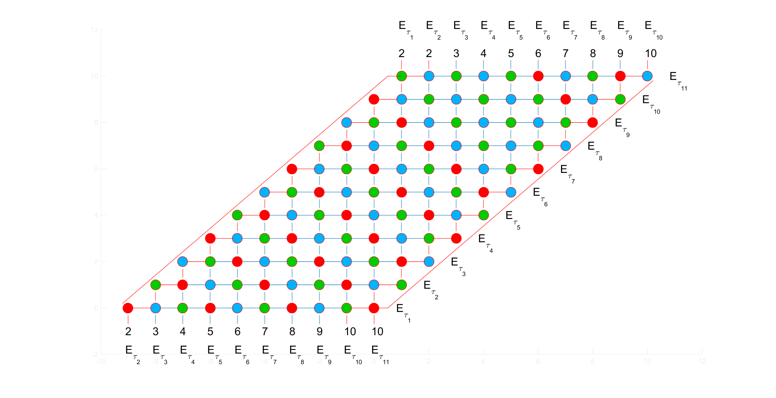
Chromatic number (with (6k+5) circles)
Base cases: 11 great circles

Slide 38
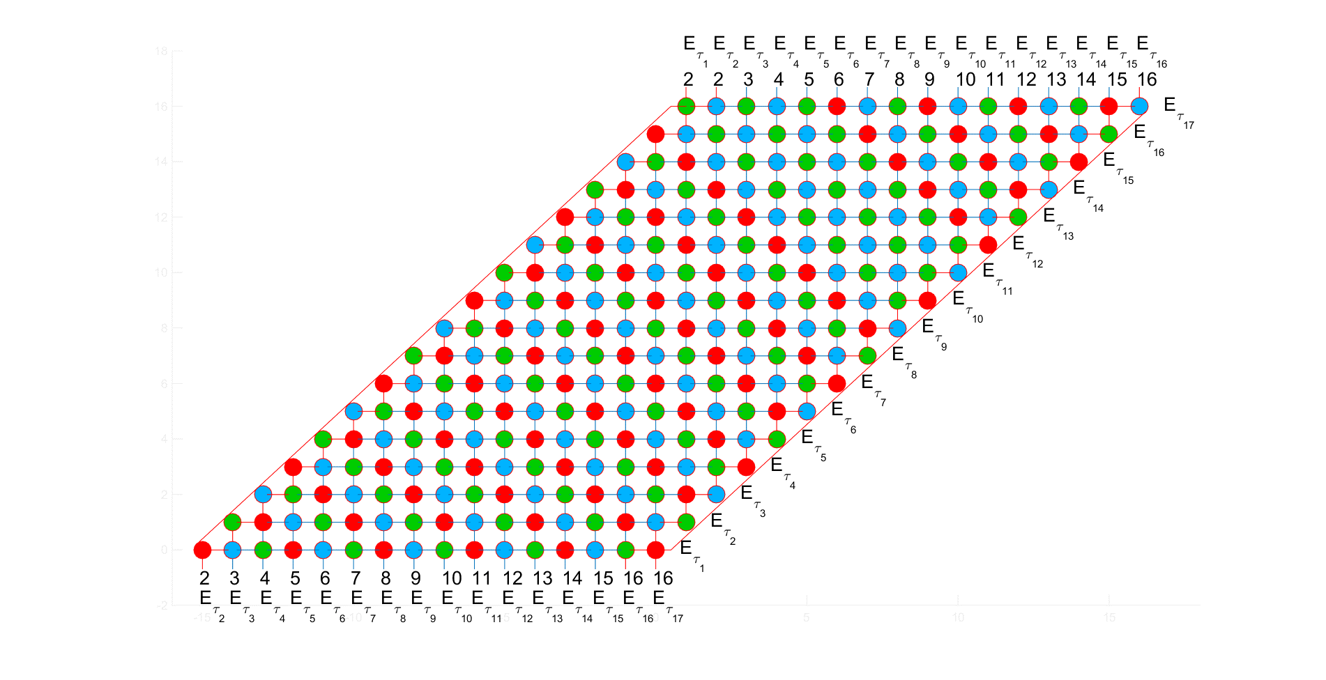
Chromatic number (with (6k+5) circles)
Base cases: 17 great circles

Slide 39
Chromatic number (with (6k+5) circles)
This type of graph is similar to (6k+1) graph. With cases k>1, by spreading RED-BLUE-GREEN respectively on the diagonals, I can color all this type of graph based on the case k=1

Slide 40

Chromatic number
According to the techniques to color the graphs including 3k, 2k, 6k+1 and 6k+5 great circles, there are only 3 colors used
➔ $χ\left(G\right)=3$

Slide 41
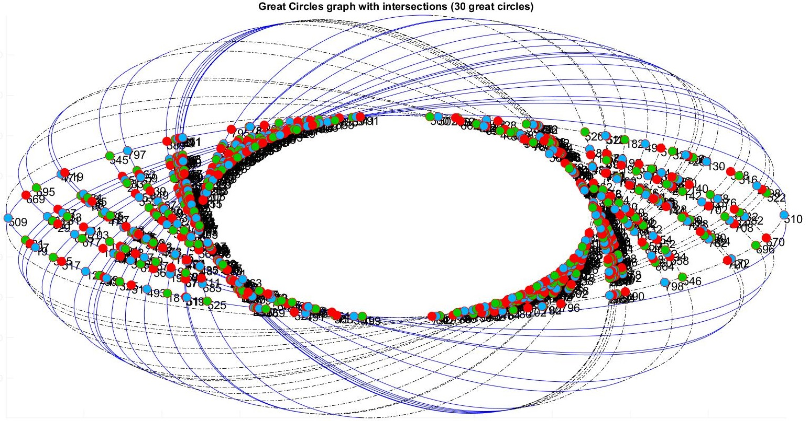
Bonus

Slide 42
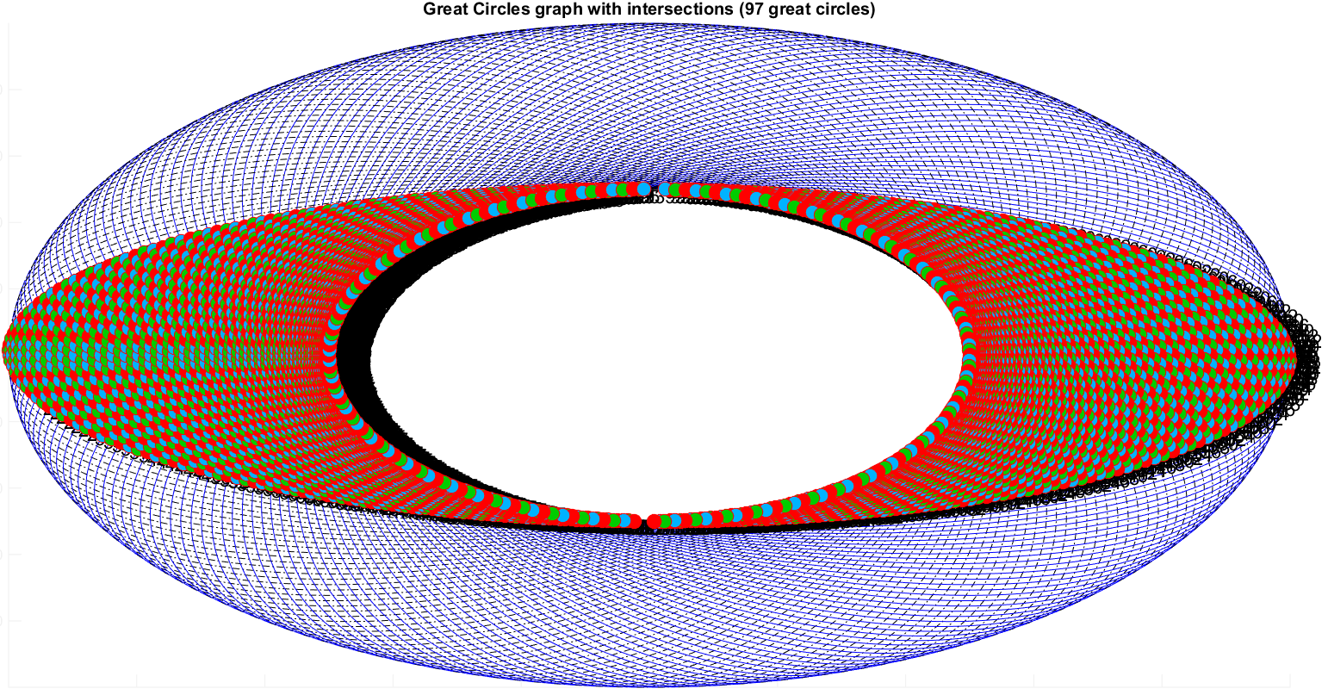
Bonus
Only takes 0.12s to find colors in this graph on my laptop

Slide 43
Thank you

